Slide 1
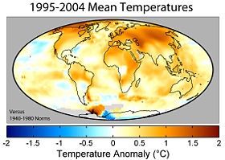
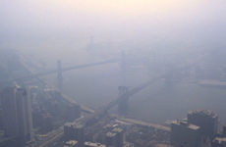
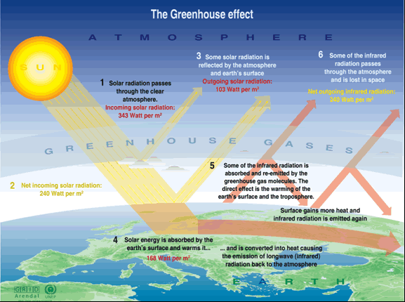
Anthropogenic Climate Change, Part one: The settled issues

Slide 2
Topics
What has been established? What is at issue?
Definitions
Science
The Scientific Consensus
An absurdity which needs to be addressed
Some common challenges to anthropogenic climate change (and why they fail)

Slide 3
What has been established?
The Earth is warming up.
Carbon dioxide acts as a positive radiative forcing, and increases in carbon dioxide contribute to increases in temperature via the greenhouse effect.
Humans are responsible for a significant increase in carbon dioxide, and therefore responsible for a warming trend.
Carbon dioxide levels and mean global temperatures today are irregular in comparison to the last several thousand years.

Slide 4
What is at issue?
The accuracy of climate models
The immediacy and gravity of the consequences
The proper response
[ Topics for Part II ]

Slide 5
Definitions
Climate:
- “average weather”
The statistics of temperature, humidity, atmospheric pressure, wind, rainfall, atmospheric particle count and other meteorological elemental measurements in a given region over long periods.
- the state of the climate system

Slide 6
Definitions
Climate System:
highly complex system consisting of five major components: the atmosphere, the hydrosphere, the cryosphere, the land surface and the biosphere, and the interactions amongst them.

Slide 8
What factors determine Earth’s climate?
Internal dynamics and external forcings:
external forcings include natural phenomena (volcanic eruptions, solar variations) as well as human-induced changes in atmospheric composition

Slide 9
Definitions
Climate change:
a statistically significant variation in either the mean state of the climate or in its variability, persisting for an extended period of time

Slide 10
Science

Slide 11
The Earth is warming up

Slide 12
The Earth is warming up

Slide 13
The Earth is warming up

Slide 14
The Earth is warming up

Slide 15
The Earth is warming up
“Temperatures have risen 1.4 degrees Fahrenheit since the start of the 20th century – with much of this warming occurring in just the last 30 years – and temperatures will likely rise at least another 2 degrees F, and possibly more than 11 degrees F, over the next 100 years.” - Report from the National Academy of Sciences (NAS)
“Three major global surface temperature reconstructions show that Earth has warmed since 1880. Most of this warming has occurred since the 1970s, with the 20 warmest years having occurred since 1981 and with all 10 of the warmest years occurring in the past 12 years.” - NASA
“Scientific evidence for warming of the climate system is unequivocal.” - Intergovernmental Panel on Climate Change (IPCC)

Slide 16
Definitions
Greenhouse gas:
a gas in an atmosphere that absorbs and emits radiation within the thermal infrared range
Radiative forcing:
a measure of how the energy balance of the Earth-atmosphere system is influenced when factors that affect climate are altered

Slide 17
Carbon dioxide as a significant, positive radiative forcing

Slide 18
Carbon dioxide as a significant, positive radiative forcing

Slide 19
Carbon dioxide as a significant, positive radiative forcing

Slide 20
Human activities are significantly increasing carbon dioxide levels.
There are no known natural sources of CO₂ sufficient to account for the recent increase.
There are no known sinks of CO₂ sufficient to have absorbed all the CO₂ from fossil-fuel burning.
For more than 10,000 years prior to the Industrial Revolution, atmospheric CO₂ levels were essentially constant, which shows that the recent increase is not natural.
The pattern of CO₂ increase since 1958 has closely mirrored that of fossil-fuel burning.

Slide 21
Human activities are significantly increasing carbon dioxide levels.

Slide 22
Carbon dioxide levels and mean global temperatures are irregular in comparison to the last several thousand years.

Slide 25
Seminal study in Science of Arctic lake sediments, tree rings, and glacial ice

Slide 29
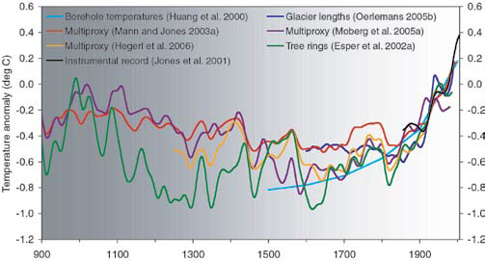
Scientists analyzed tree rings, ice cores, ocean sediments, and a number of other “proxy” indicators to estimate past climatic conditions. The results (via Surface Temperature Reconstructions for the last 2,000 years, which is a synthesis of seven independent research teams’ findings):

Slide 30
From the conclusion of that study:
“..[we can conclude], with a high level of confidence, that global mean surface temperature was higher during the last few decades of the 20th century than during any comparable period since at least A.D. 1600.”
“Estimating the Earth’s global-average temperature becomes increasingly difficult going further back in time due to the decreasing availability of reliable proxy evidence, but the available evidence indicates that most regions are warmer now than at any other time since at least A.D. 900.”

Slide 31
The Scientific Consensus

Slide 32
Scientific Consensus: Synthesis Reports
Intergovernmental Panel on Climate Change (2007)
U.S. Global Change Research Program

Slide 33
Scientific Consensus: Various Organizations
Since 2001, 32 national science academies, including those of Brazil, Japan, Germany, Canada, France, China, India, Russia, Italy, the UK, and the US, have come together to issue joint declarations confirming anthropogenic climate change.
Within America, several science organizations affirm the authenticity of anthropogenic climate change, including:
American Association for the Advancement of Science
American Chemical Society
American Institute of Physics
American Physical Society
American Geophysical Union
Geological Society of America

Slide 34
Scientific Consensus: Surveys
Oreskes Survey (2004)
STATS (2007)
Bray and Von Storch (2008)
Anderegg, Prall, Harold, and Schneider (2010)
Skeptical Science (2011)

Slide 35
Scientific Consensus: Are we totally sure?
“There are still some uncertainties, as there always will be in understanding a complex system like Earth’s climate. Nevertheless, there is a strong, credible body of evidence, based on multiple lines of research, documenting that climate is changing and that these changes are in large part caused by human activities.”
(United States National Research Council, Advancing the Science of Climate Change)

Slide 36
The Absurdity
Does one’s ideology as a conservative or liberal have any effect on whether or not one accept the truth of:
Copernican Heliocentrism
Newton’s Laws
Hooke’s Cell Theory
Einstein’s Theory of Relativity
Avogadro’s Law
The Laws of Thermodynamics
????

Slide 37
Common Challenges to Anthropogenic Climate Change

Slide 38
The Medieval Warm Period/Medieval Climate Anomaly (MWP) was warmer than conditions today.
Volcanoes emit more CO₂ in a single eruption (or per year) than humanity does, dwarfing anthropogenic emissions.

Slide 39
Why is this important?

Slide 40
Sources
IPCC Fourth Assessment Report, 2007
IPCC Fourth Assessment Report, Summary for Policymakers
V. Ramaswamy et.al., “Anthropogenic and Natural Influences in the Evolution of Lower Stratospheric Cooling,” Science 311 (24 February 2006), 1138-1141
National Research Council (NRC), 2006. Surface Temperature Reconstructions For the Last 2,000 Years. National Academy Press, Washington, DC.
http://www.ncdc.noaa.gov/oa/climate/research/ anomalies/index.html
http://www.cru.uea.ac.uk/cru/data/temperature
http://data.giss.nasa.gov/gistemp
http://climate.nasa.gov/
Climate Change 2001: Working Group I: The Scientific Basis, IPCC, January 2001.
http://www.giss.nasa.gov/research/news/20100121/
http://science.nasa.gov/headlines/y2009/ 01apr_deepsolarminimum.htm
http://www.eoearth.org/article/Climate_change_FAQs#gen0
Forster, P., V. Ramaswamy, P. Artaxo, T. Berntsen, R. Betts, D.W. Fahey, J. Haywood, J. Lean, D.C. Lowe, G. Myhre, J. Nganga, R. Prinn, G. Raga, M. Schulz and R. Van Dorland, 2007: Changes in Atmospheric Constituents and in Radiative Forcing.
Understanding and Responding to Climate Change: National Academy of Sciences
http://www.ncdc.noaa.gov/cmb-faq/anomalies.php#anomalies
http://www.esrl.noaa.gov/gmd/ccgg/trends/
http://www.ncdc.noaa.gov/paleo/pubs/mann2008/mann2008.html
Oreskes, Naomi (2007). "The Scientific Consensus on Climate Change: How Do We Know We’re Not Wrong?". In DiMento, Joseph F. C.; Doughman, Pamela M.. Climate Change: What It Means for Us, Our Children, and Our Grandchildren. The MIT Press. p. 68.
http://www.bis.gov.uk/go-science/climatescience
http://www.brighton73.freeserve.co.uk/gw/globalwarmingfaq.htm
http://oceanservice.noaa.gov/education/literacy.html
http://www.pewclimate.org/global-warming-basics/faq_s/glance_faq_science.cfm
Plus many other links for the graphs and illustrations, most of which came from NASA and IPCC.

